Slide 1
Modern Computing Architecture
Von Neumann Architecture
&
Flynn's classification

Slide 2
Von Neumann Architecture
Von Neumann architecture was first published by John von Neumann in 1945.
Neumann architecture design consists of
Control Unit,
Arithmetic and Logic Unit (ALU),
Memory Unit,
Registers and
Inputs/Outputs.
Uses a single processor
Uses one memory for both instructions and data.
Executes programs following the fetch-decode-execute cycle.

Slide 3
Von Neumann Architecture
Von Neumann architecture is based on the stored-program computer concept, where instruction data and program data are stored in the same memory.
Fixed Program Computers– Their function is very specific and they couldn’t be programmed, e.g. Calculators.
Stored Program Computers– These can be programmed to carry out many different tasks, applications are stored on them. Programs and data are stored in memory.

Slide 4
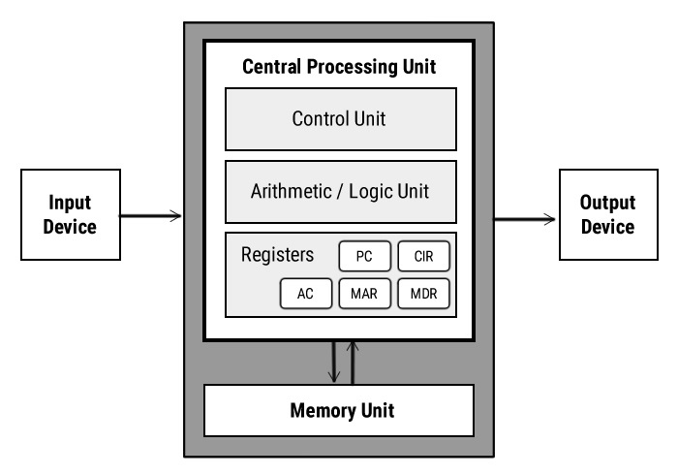
Von Neumann Architecture

Slide 5
Von Neumann Architecture
Registers
Registers are high speed storage areas in the CPU. All data must be stored in a register before it can be processed.
MAR | Memory Address Register | Holds the memory location of data that needs to be accessed
MDR | Memory Data Register | Holds data that is being transferred to or from memory
AC | Accumulator | Where intermediate arithmetic and logic results are stored
PC | Program Counter | Contains the address of the next instruction to be executed
CIR | Current Instruction Register | Contains the current instruction during processing

Slide 6
Von Neumann Architecture
Memory stores both the data values and the program instructions.
During execution, an instruction is read from the memory and decoded, appropriate operands are fetched from the memory, and, finally, the instruction is executed.
The main disadvantage is that memory bandwidth becomes the bottleneck in such an architecture.
Several memory buses and on-chip memories are therefore used so that reads and writes to different memory units can take place concurrently.

Slide 7
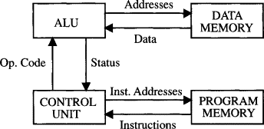
Von Neumann Architecture
Two separate memories are used

Slide 8
Flynn's classification
The most popular taxonomy of computer architecture was defined by Flynn in 1966.
Flynn's classification scheme is based on the notion of a stream of information.
Two types of information flow into a processor: instructions and data.
The instruction stream is defined as the sequence of instructions.
The data stream is defined as the sequence of data and exchanged between the memory and the processing unit.

Slide 9
Flynn's classification
Instructions are decoded by the control unit and then control unit send the instructions to the processing units for execution.
Data Stream flows between the processors and memory bi directionally.
A sequential computer which exploits no parallelism in either the instruction or data streams.

Slide 10
Flynn's classification
According to Flynn's classification, either of the instruction or data streams can be single or multiple.
Computer architecture can be classified into the following four distinct categories:
Single Instruction Single Data Streams (SISD)
Single Instruction Multiple Data Streams (SIMD)
Multiple Instruction Single Data Streams (MISD)
Multiple Instruction Multiple Data Streams (MIMD)

Slide 11
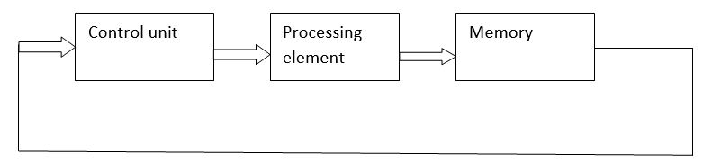
Flynn's classification
Single Instruction Single Data Streams (SISD)
A serial (non-parallel) computer
Single Instruction: Only one instruction stream is being acted on by the CPU during any one clock cycle
Single Data: Only one data stream is being used as input during any one clock cycle

Slide 12
Flynn's classification
Single Instruction Single Data Streams (SISD)
This is the oldest type of computer
Examples: older generation mainframes, minicomputers, workstations and single processor/core PCs.

Slide 13
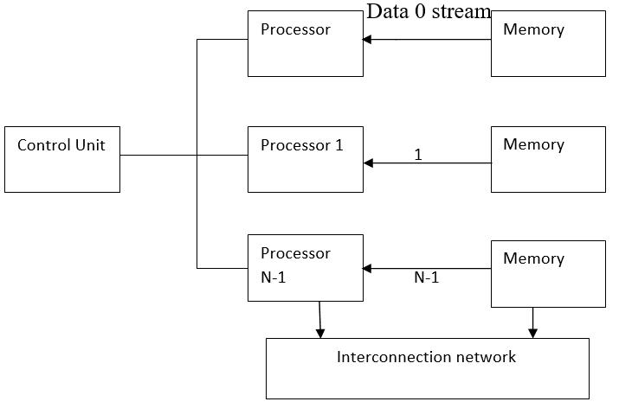
Flynn's classification
Single Instruction Multiple Data Streams (SIMD)
A type of parallel computer
Single Instruction: All processing units execute the same instruction at any given clock cycle
Multiple Data: Each processing unit can operate on a different data element

Slide 14
Flynn's classification
Single Instruction Multiple Data Streams (SIMD)
Best suited for specialized problems characterized by a high degree of regularity, such as graphics/image processing.
Two varieties: Processor Arrays and Vector Pipelines

Slide 15
Flynn's classification
Single Instruction Multiple Data Streams (SIMD)
Processor Arrays: Thinking Machines CM-2, MasPar MP-1 & MP-2, ILLIAC IV
Vector Pipelines: IBM 9000, Cray X-MP, Y-MP & C90, Fujitsu VP, NEC SX-2, Hitachi S820, ETA10
Most modern computers, particularly those with graphics processor units (GPUs) employ SIMD instructions and execution units.

Slide 16
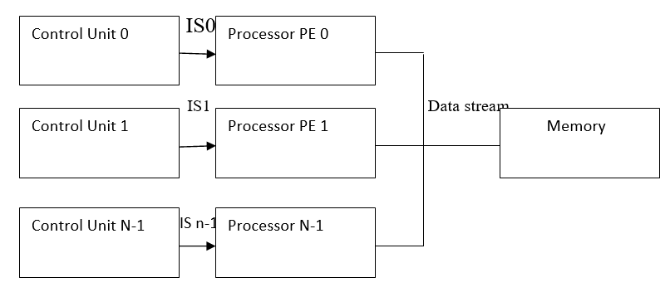
Flynn's classification
Multiple Instruction Single Data Streams (MISD)
A type of parallel computer
Multiple Instruction: Each processing unit operates on the data independently via separate instruction streams.
Single Data: A single data stream is fed into multiple processing units.

Slide 17
Flynn's classification
Multiple Instruction Single Data Streams (MISD)
Few (if any) actual examples of this class of parallel computer have ever existed.
Some conceivable uses might be:
multiple frequency filters operating on a single signal stream
multiple cryptography algorithms attempting to crack a single coded message.

Slide 18
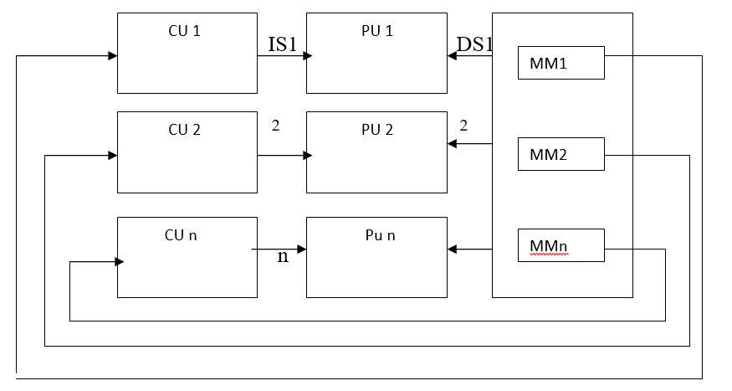
Flynn's classification
Multiple Instruction Multiple Data Streams (MIMD)
A type of parallel computer
Multiple Instruction: Every processor may be executing a different instruction stream
Multiple Data: Every processor may be working with a different data stream

Slide 19
Flynn's classification
Multiple Instruction Multiple Data Streams (MIMD)
Execution can be synchronous or asynchronous, deterministic or non-deterministic
Currently, the most common type of parallel computer - most modern supercomputers fall into this category.

Slide 20
Flynn's classification
Multiple Instruction Multiple Data Streams (MIMD)
Examples: most current supercomputers, networked parallel computer clusters and "grids", multi-processor SMP computers, multi-core PCs.
Note: many MIMD architectures also include SIMD execution sub-components

Slide 21
Flynn's classification
Parallel computers are either SIMD or MIMD

